Slide 1

Organ Donation Management System:-
Group:- Interpreters
Team Members:- Abhi Thakkar
Krutarth Vanesa

Slide 2
Uses of the System:-
The purpose of this study is to develop an Organ donation management information system to assist in the management of organ distribution to the hospital of area as per the demands of the organs.

Slide 3
Which issue is solved?
The system is an attempt to make the process easy of finding and donating an organ for the organ donor and receiver.
Also, to keep a proper record of the donations.

Slide 4
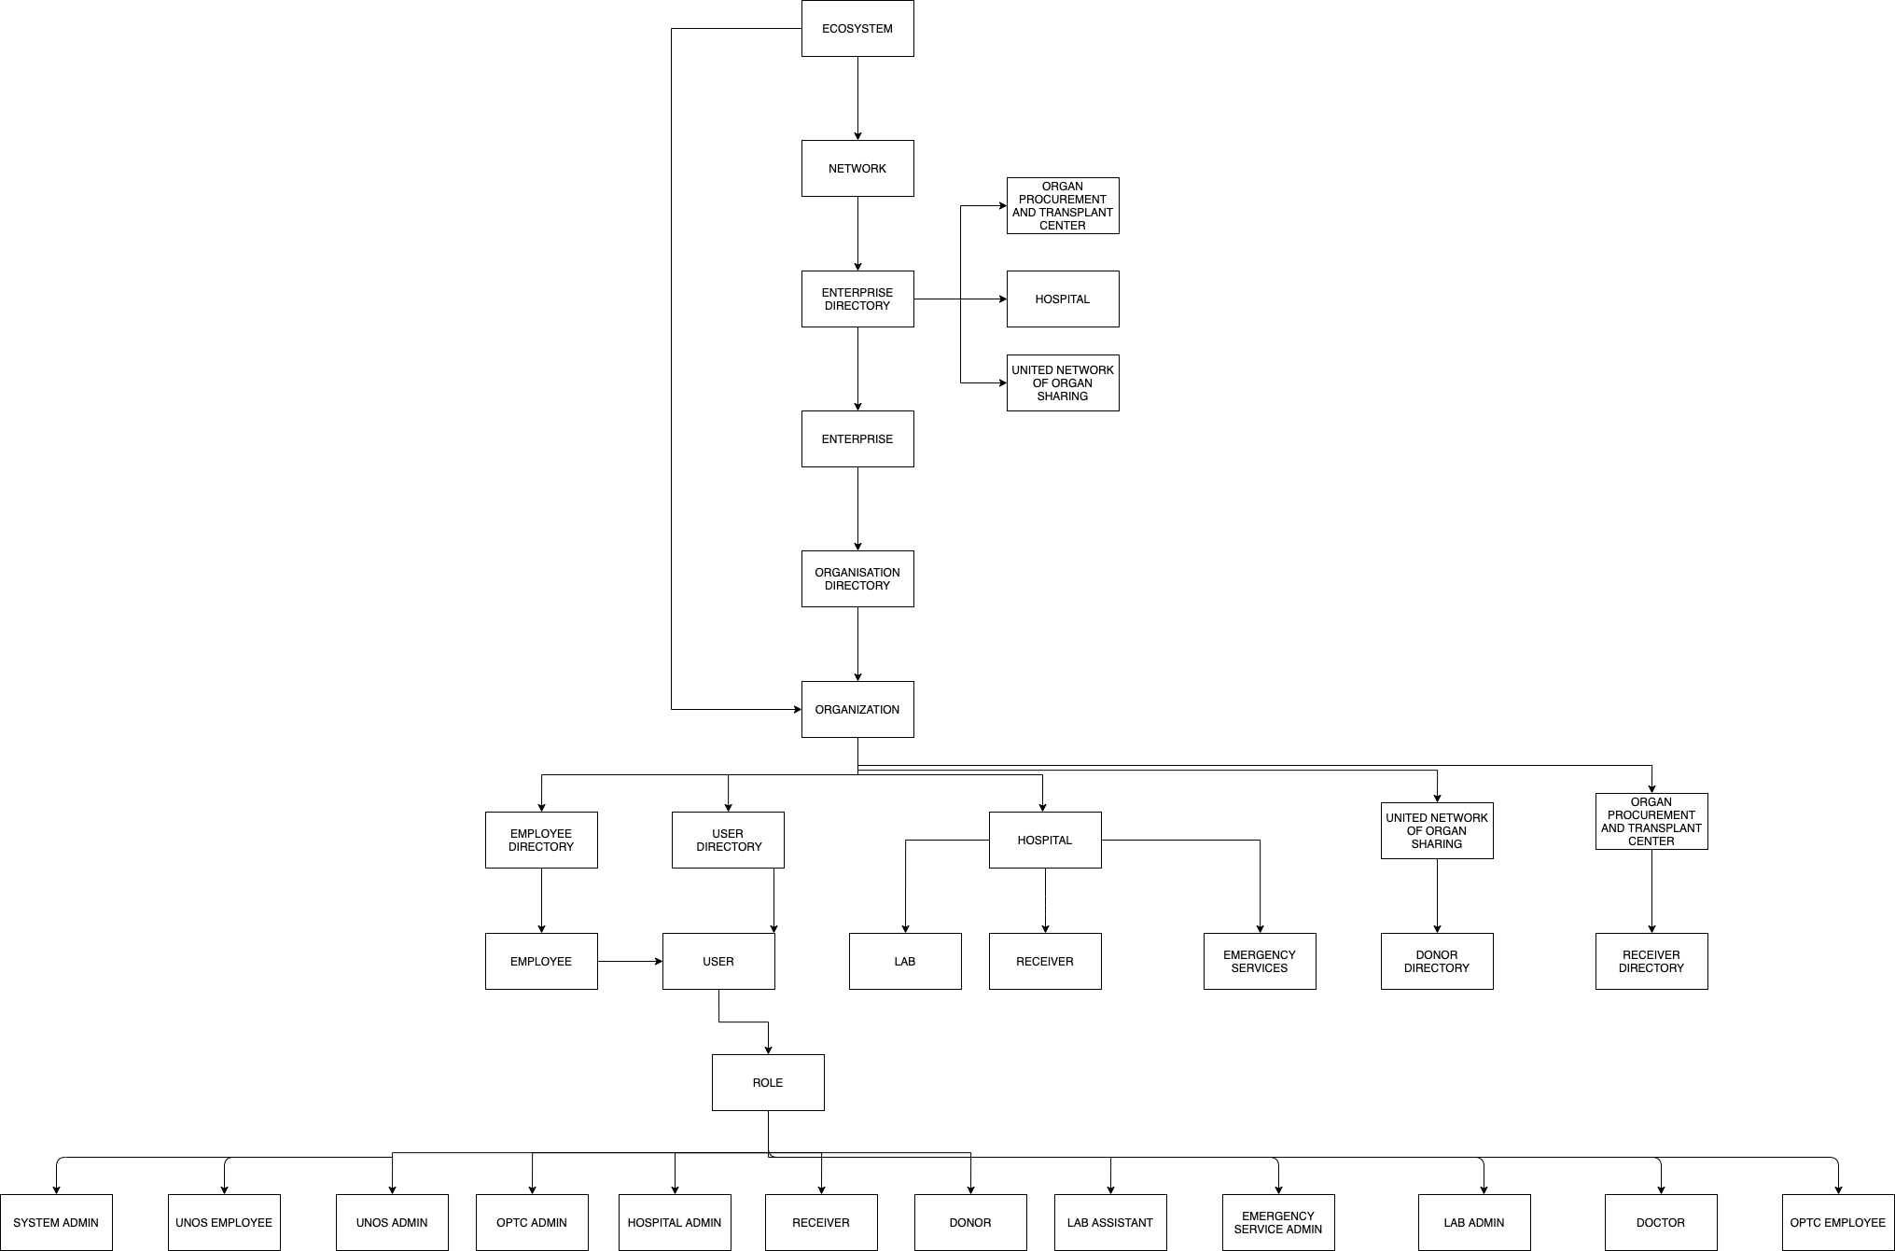
Eco-System and Architecture Diagram

Slide 5
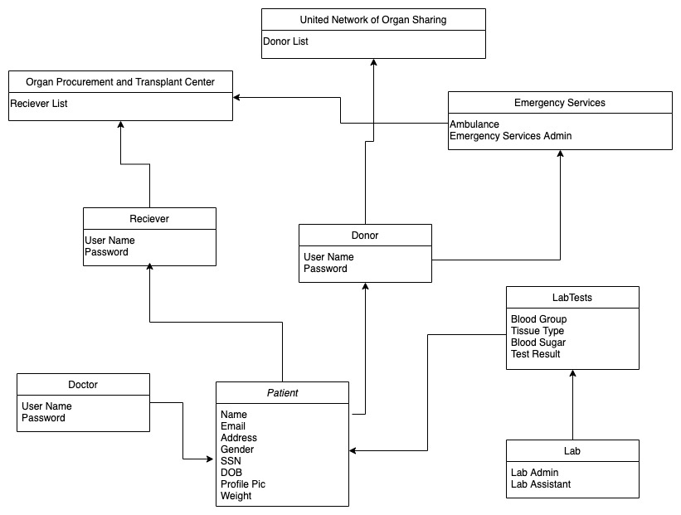
UML Diagram:-

Slide 6
Roles:-
System Admin
UNOS Employee
UNOS Admin
OPTC Admin
OPTC Employee
Doctor
Lab Admin
Lab Assistant.
Donor
Receiver.
Emergency service admin.

Slide 7
Work flow:-
The person who is willing to donate his/her organs has to register with” United network of organ sharing (UNOS)” via hospitals..
The donor is supposed to go under medical tests conducted at labs and all their medical reports are being collected.
All the records of the donors are sent to UNOS. Hence, it consists of the list of the donors and their reports.
The person who has organ failure acts as receivers are supposed to register themselves at “Organ procurement and transplant center (OPTC)” via hospitals.

Slide 8
WorkFlow:-
The OPTC will send the list of the receivers with their requirements to the UNOS.
When the person dies the hospital will check whether the person is a donor. If he/she is the donor hospital will send the donor body to UNOS. And notifies the death registry about the death.
Once the UNOS receives the donor’s body it will find the best fit receiver. UNOS will inform OPTC about it.
The OPTC will inform the receiver and the hospital about the match and suggest for the transplant surgery.

Slide 9


